Slide 1
ITE204
UNIT 1

Slide 2
Unit I- Fundamentals of computer Architecture
Introduction and Organization of von Neumann machine
Instruction formats
The fetch/execute cycle
Instruction decoding and execution
Registers and registers files
Instruction types and addressing modes
Subroutine call and return mechanisms
Programming in assembly language
I/O techniques and interrupts
Other design issues

Slide 3
First Generations
Vacuum Tubes
Magnetic Drum
4,000 bits
Hard Wire Programs in computers
IBM 650, Univac I
ENIAC

Slide 4

Vacuum Tube

Slide 5
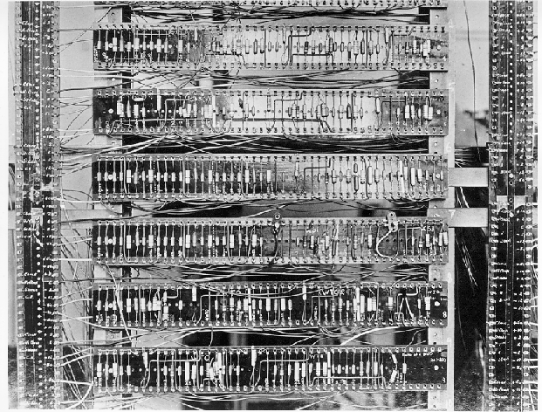
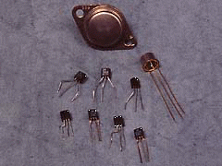
2nd Generation: Transistor Based Computers
Transistors replaced
vacuum tubes
Smaller
Cheaper
Less heat dissipation
Made from Silicon (Sand)
Invented 1947 at Bell Labs
William Shockley et al.
Commercial Transistor based computers:
  NCR (National Cash Register) & RCA(Radio Corporation of America) produced small transistor machines
  IBM 7000
  DEC – 1957 (PDP-1)(Programmed data processor)
First transistor computer – Manchester University 1953.

Slide 6
Second Generation (1958-1964)
1958 Philco introduces TRANSAC S-2000
  first transistorized commercial machine
IBM 7070, 7074 (1960), 7072(1961)
1959 IBM 7090, 7040 (1961), 7094 (1962)
1959 IBM 1401, 1410 (1960), 1440 (1962)
FORTRAN, ALGOL, and COBOL are first standardized programming languages

Slide 7
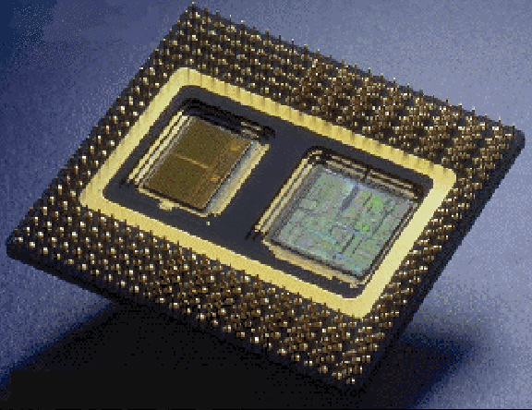
3rd Generation: Integrated Circuits
A single, self-contained transistor is called a discrete component.
Transistor based computers – discrete components manufactured separately, packaged in their
own containers, and soldered
or wired together onto circuit
boards.
Early 2nd generation
computers contained
about 10,000
transistors – but grew to
hundreds of thousands!!!!
Integrated circuits
revolutionized electronics.
Silicon Chip – Collection of tiny transistors

Slide 8
Third Generation (1964-1971)
April 1964 IBM announces the System/360
  solid logic technology (integrated circuits)
  family of “compatible” computers
1964 Control Data delivers the CDC 6600(control data corporation)
nanoseconds
telecommunications
BASIC, Beginners All-purpose Symbolic Instruction Code

Slide 9
Fourth Generation (1971- )
Large scale integrated circuits (MSI, LSI)
Nanoseconds and picoseconds
Databases (large)
Structured languages (Pascal)
Structured techniques
Business packages

Slide 10
Generations of Computers
Vacuum tube - 1946-1957 (One bit ➔ Size of a hand)
Transistor - 1958-1964 (One bit ➔ Size of a fingernail)
Small scale integration - 1965 on
Up to 100 devices on a chip
Medium scale integration - to 1971
100-3,000 devices on a chip
Large scale integration - 1971-1977
3,000 - 100,000 devices on a chip
Very large scale integration - 1978 to date
100,000 - 100,000,000 devices on a chip
Ultra large scale integration
Over 100,000,000 devices on a chip
Thousands of bits on the size of a hand
Millions of bits on the size of a fingernail.

Slide 11
Introduction
What is computer Architecture?
  Refers to those attributes of a system visible to a programmer or
  those attributes that have a direct impact on the logical execution of the program.
  Eg. For architectural attributes:
    instruction set,
    no. of bits used to represent the various data types( nos. and characters)
    I/O mechanisms and techniques for addressing memory.
What is computer organization?
  Refers to the operational units and their interconnections that realize the architectural specifications.
  Organizational attributes include
    those hardware details transparent to the programmer, such as
      control signals;
      interfaces between the computer and peripherals; and
      the memory technology used

Slide 12
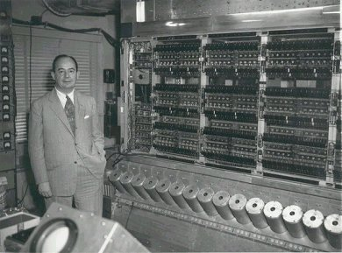
Dr. Von-Neuman with IAS machine
Stored Program Concept
Main memory storing programs
and data
ALU operating on binary data
Control unit interpreting
instructions from memory and
executing
Input and output equipment
operated by control unit
Princeton Institute for Advanced
Studies (IAS).
Completed 1952

Slide 13
Difference between computer Architecture and organization
architecture is like a blue print, it will have all the components mentioned and also how they are connected, where as organization is an implementation of that blue print, each vendor will have their own version of the organization, their own way of implementing the blue print.
Many computer manufactures offer a family of computer models, all with the same architecture but with differences in organization.
Consequently, the different models in the family have different price and performance characteristics.
Further more, a particular architecture may span for many years and encompasses a number of different computer models, its organization changing technology.

Slide 14
von Neumann Machine
Stored Program concept:
  The task of entering and altering programs for the ENIAC was extremely tedious.
  The programming process could be facilitated if the program could be presented in a form suitable for storing in memory alongside the data.
  Then a computer could get its instructions by reading them from memory, and a program could be set or altered by setting the values of a portion of memory.
  The stored program concept idea is given by a mathematician John Von Neumann, who was the consultant on the ENIAC project.

Slide 15
General Structure of the IAS computer:
In 1946, Princeton Institute for Advanced Studies Von Neumann and his colleagues began the design of a new stored program computer, referred as IAS computer, at the Princeton Institute for Advanced Studies.
The IAS computer, although not completed until 1952, is the prototype of all subsequent general-purpose computers.
General Structure of the IAS computer:
  Main memory storing programs and data
  ALU operating on binary data
  Control unit interpreting instructions from memory and executing
  Input and output equipment operated by control unit.

Slide 16

Structure of von Neumann machine/ structure of IAS computer

Slide 17
Structure of von Neumann machine/ structure of IAS computer
Central Arithmetic part: (CA) C=CA+CC
  To perform the elementary operations of arithmetic most frequently(+ - * /)
Central control: (CC)
  Proper sequencing of operations
Total memory: (M)
  Any device which is to carry out long and complicated sequences of operations must have a considerable memory
Input unit: (I)
  The device must have organs to transfer information from R into its specific parts C and M.
Output unit: (O)
  The device must have organs to transfer from its specific parts C and M into R.

Slide 18
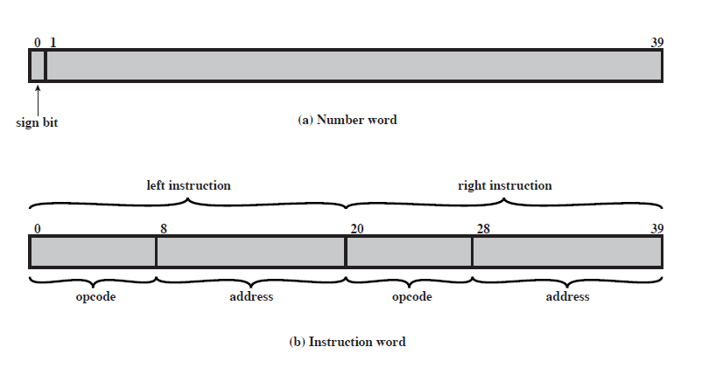
IAS Memory Formats

Slide 19
IAS – memory format
1000 x 40 bit words ( 1000 storage locations of 40 binary bits each)
  Binary number( both data and instructions are stored here
Number Format:
  Each number is represented by a sign bit and a 39 bit value.
Instruction Format:
  A word may contain 20 bit instruction with each instruction consisting of an 8 bit operation code (opcode) specifying the operation to be performed and a 12 bit address designating one of the words in memory (0 to 999)

Slide 20

Structure of IAS –detail

Slide 21
Expanded structure of IAS computer
Set of registers (storage in CPU)
  Memory Buffer Register (MBR)
    Contains a word to be stored in memory or sent to the I/O unit, or it is used to receive a word from memory or from the I/O unit.
  Memory Address Register (MAR)
    Specifies the address in memory of the word to be written from or read into the MBR.
  Instruction Register (IR)
    Contains the 8 bit opcode instruction being executed.
  Instruction Buffer Register (IBR)
    Employed to hold temporarily the right hand instruction from a word in memory
  Program Counter (PC)
    Contains the address of the next instruction pair to be fetched from memory
  Accumulator (AC) & Multiplier Quotient (MQ)
    Employed to hold temporarily the right hand instruction from a word in memory. For eg. The result of multiplying two 40 bit numbers is an 80 bit number, the most significant 40 bits are stored in the AC and the least significant in the MQ.

Slide 22
Size of

Slide 23
Size of
AC –40 BITS
MQ –40 bits
MBR –40 bits
IBR –20 bits
IR –8 bits
MAR –12 bits
PC – 12 bits

Slide 24
AC = 7
AC = 3
MEMORY
1. LOAD M(X) 500, ADD M(X) 501
2. STOR M(X) 500, (Other Ins)
.....
3
4
AC
MQ
500
MBR = 4
LOAD M(X)
MBR
MBR = 3
500
ADD M(X) 501
(Other Ins)
STOR M(X)
PC
1
2
MAR
1
500
501
2
500
MBR
LOAD M(X) 500, ADD M(X) 501
3
4
STOR M(X) 500, (Other Ins)
IR
LOAD M(X)
ADD M(X)
STOR M(X)
IBR
ADD M(X) 501
(Other Ins)
AC
3
501
PC = 2
7
IBR
PC = 1
Add M(X)
Mar ← PC
MAR ←PC
3
LOAD M(X) 500, ADD M(X) 501
4
IR
MAR = 2
STOR M(X) 500, (Other Ins)
MAR = 501
MAR = 1
MAR = 500
MAR =500
add = 501
add = 1
add = 500
add = 2

Slide 25
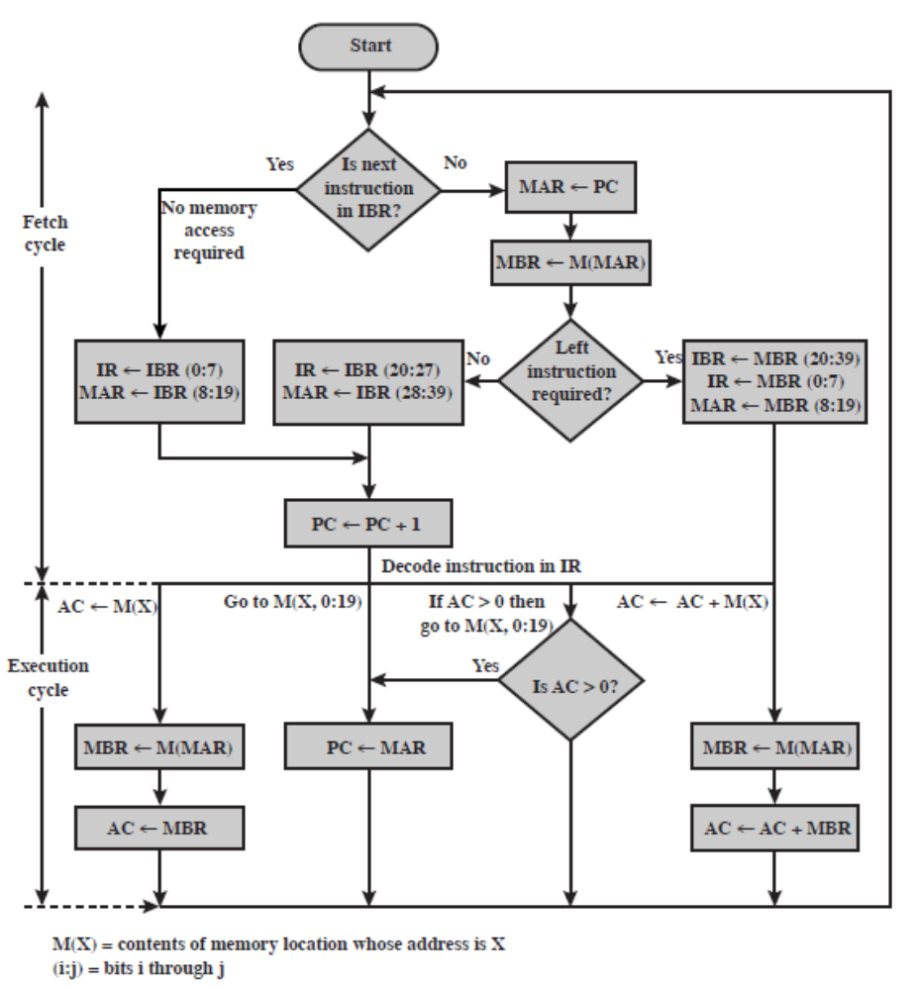
Partial Flowchart of IAS Operation

